Slide 1


CPE003L
FINAL PROJECT
Group 7
BERMOY_BULING_CATAN_HAO.py

Slide 2

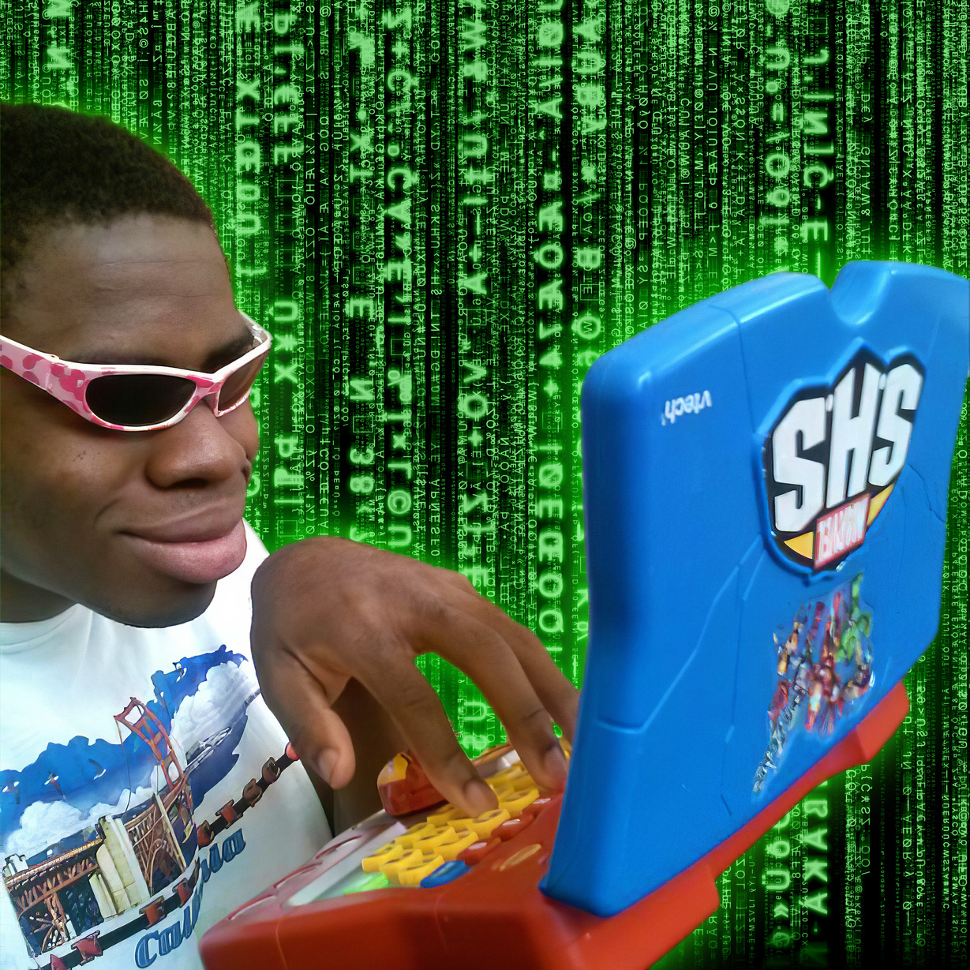
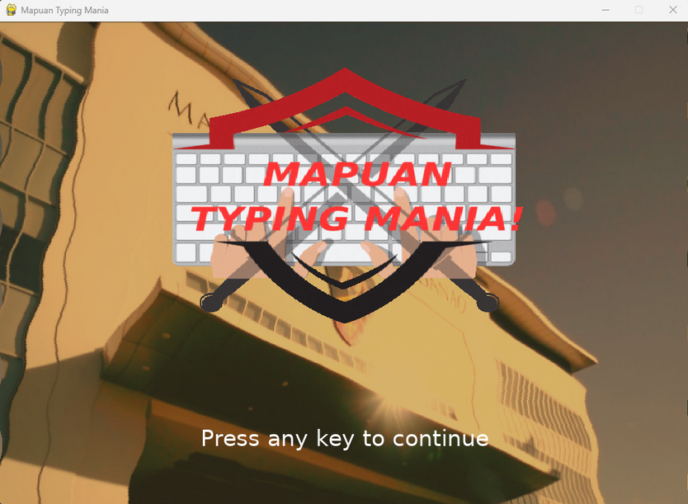
Mapuan
Typing Mania
Type for your grades,
and for your life!

Slide 3
GAME MECHANICS

Slide 4
GAME CONCEPT
A game where you type type type! You are
thrusted into a world of typing.
Prepare your hands, ready your wrists, and
stretch those fingers!
A game with the simple mechanic of
typing with your keyboard. Attempt to
type in the correct keys, symbols, and
words to defeat your enemies and get at
the end of your typing adventure. Failure
to type and you will experience
punishment and a game over.

Slide 5
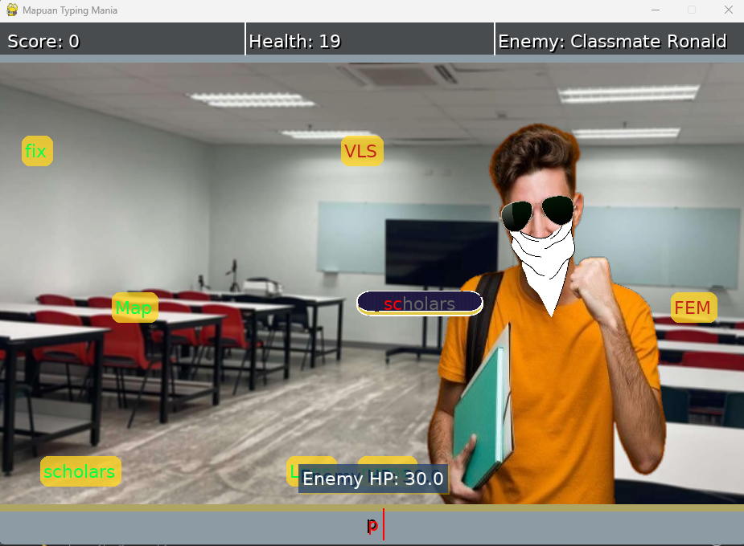
GAME RULES
Words drop from above. Each typed word
will result in a score. Words typed in the
indicated text box will result in an enemy
getting their health reduced.
Failure to type these words will end in
allowing the enemy to.
complete their word and damage you.
Failure to also prevent the words from getting
to the bottom will punish you
Empty your opponents
hitpoints before yours does and win. Each
stage more difficult than the last, reach the
ending to win the Mapuan Typing Mania!

Slide 6
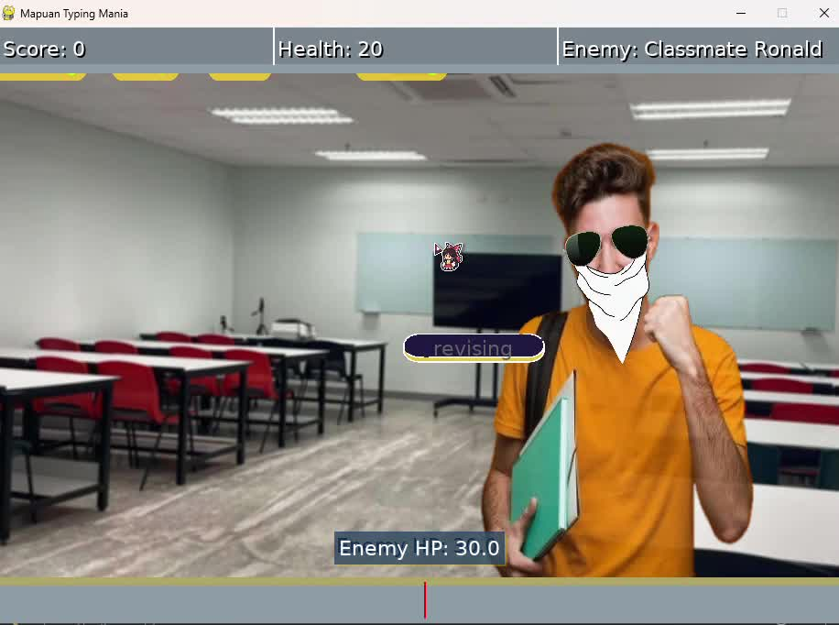
GAMEPLAY SAMPLE

Slide 7
PYTHON CODE STRUCTURES

Slide 8
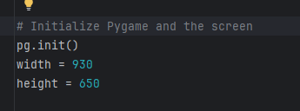
SEQUENTIAL STRUCTURES
A sequential structure in coding refers to a control flow where instructions are executed one after another in the order they appear.
The code here shows the sequential statements. First line is the pg.init.
pg stands for pygame, pg.init() it is being initialized to be used for the whole code.
The other two initializes the variable width and height for the screen of the entire window. They are executed in order
and when the game starts up and pop
up a window.

Slide 9
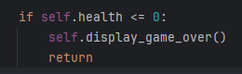
2. Decision Structures
A decision structure in coding is a control flow that allows the program to make choices based on conditions, typically using if, elif, and else statements.
The code shows the decision that if the players health is equal or less than zero then the game will display a windows with a game over screen. This happens only if you fail to type fast enough during a battle sequence. The return is used to exit the method of displaying a game over screen immediately.

Slide 10
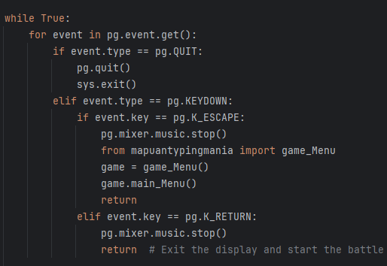
3. REPITITION STRUCTURES
A repetition structure in coding allows a set of instructions to be executed multiple times using loops, such as for and while, until a specified condition is met.
In this code here it shows a loop where unless the conditions are met certain methods will be called. For example when the event.key is == pg.KEYDOWN which means if the user presses the key esc key then it will go back to the menu of the game and stop playing the music.

Slide 11
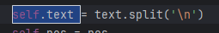
4. STRING METHODS
String methods are functions that perform operations on strings.
In this single line of code. A string method is used on the variable text to split the words
whenever a \n is stumbled upon, \n standing for newline which allows string to go down on the next line. This is used when giving out an introduction for each stage chosen by the player. This single line of code is responsible for moving sentences onto a new line in the screen instead of just one line all over the screen.

Slide 12
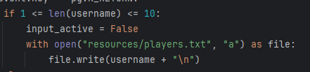
5. TEXT FILE MANIPULATION
Text file manipulation in coding refers to reading, writing, modifying, and managing text files to store or process data.
The code shows that if the username input is not greater than 10 and less than 1 letters then it will open the text file players.txt, and write in a new name string in the text file. Each name is inputted into a new line. This is when you start the game and we are asked a username to proceed to the menu.

Slide 13
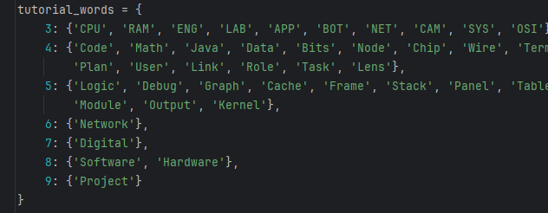
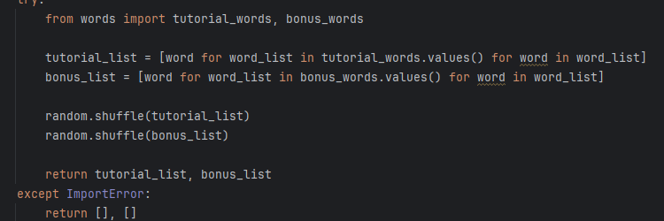
6. LIST AND DICTIONARIES
Lists store ordered items, while dictionaries store key-value pairs for quick lookups.
Top is the tutorial word dictionary.
That is used to store the words that are the gonna fall from above during gameplay.
Below is responsible for accessing said dictionary and turn into a list for the function responsible for adding words on screen during gameplay.

Slide 14
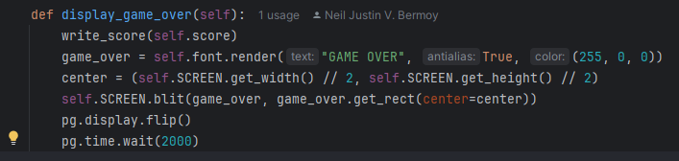
7. FUNCTIONS
Functions are reusable blocks of code that perform specific tasks when called. Recall back the decision structure from earlier. This is familiar right?
This was the function called upon when the player gets 0 hitpoints and loses the game. To display a window screen with the text GAME OVER.

Slide 15
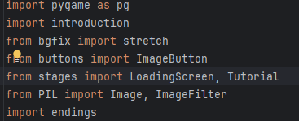
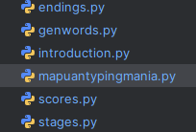
8. PROGRAM MODULARIZATION
Program modularization is the process of breaking a program into smaller, independent modules to improve organization, readability, and reusability. Shown below are the code responsbible for importing the necessary modules when starting the game. To the left are the python modules . Some modules are built in and installed in python such as pygame.

Slide 16
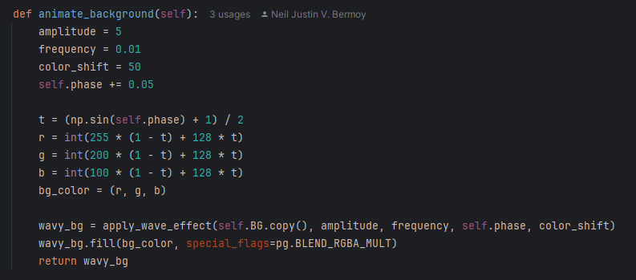
9. SIMPLE GRAPHICS AND IMAGE PROCESSING
Simple graphics and image processing involve creating, modifying, and displaying images using basic operations like drawing shapes, applying filters, and transforming pixels.
Shown below is the code responsible for having an image process and modified. This is used to display the main menu image to be wavy and have colors shift from 1 hue to another

Slide 17
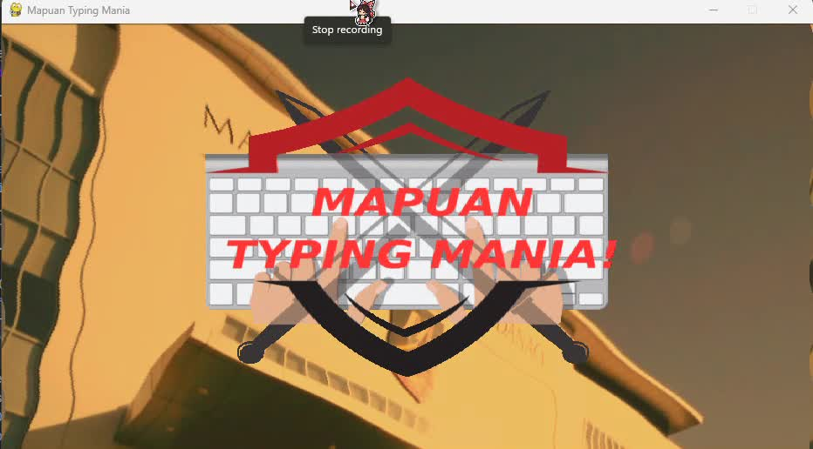
IMAGE PROCESSING AND SIMPLE GRAPHICS GAME SAMPLE
And as you will see, there is a simple graphic of logo shown onscreen drawn by pygame

Slide 18
10. GRAPHICAL USER INTERFACE
Graphical User Interfaces (GUIs) allow users to interact with a program visually using buttons, menus, and other graphical elements instead of text-based commands.
Using pygame, we made GUI to be able interacted and to be use to navigate the game and prompt users to do specific actions to get to specific displays and in other words, interface with the game

Slide 19
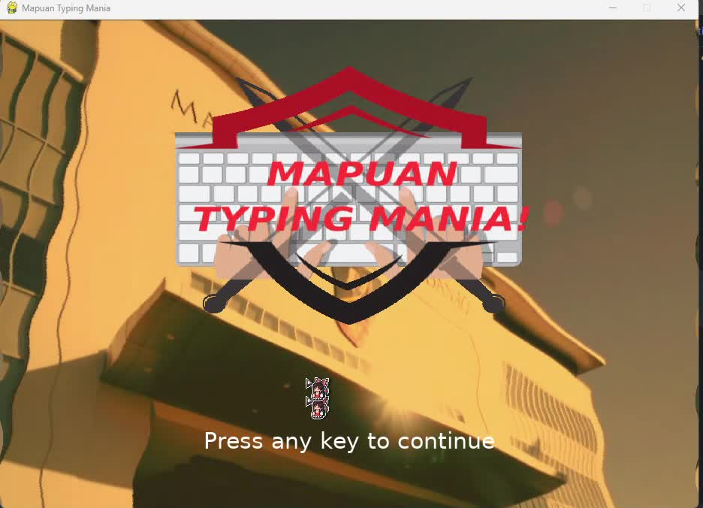
GRAPHICS USER INTERFACE GAME SAMPLE

Slide 20
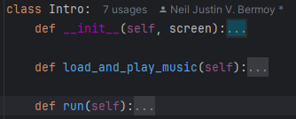
11. DESIGNING WITH CLASSES
Designing with classes means organizing code using objects that combine data and behavior, making programs more modular, reusable, and easier to manage. Just like with modules, we also used classes to make our code more manageable.
Shown below an example, the class responsible for handling the Introduction for a stage of the game. From what to display in the screen to what to prompt
and even playing music.

Slide 21
PLAYING THE GAME ITSELF

Slide 22
CONCLUSIONS AND LEARNING
Our conclusion from this project: It has been a fun, informative, and rewarding journey.
We’ve learned how to build a game from scratch using Python and its modules. We’ve experienced the struggles of turning a game idea into reality, battling with code and the editor to stay sane. We’ve explored different ways to write code to achieve the same result, rediscovering that there’s no single right answer in programming.
Along the way, we’ve developed problem-solving skills, patience, and creativity. Most importantly, we’ve gained a deeper appreciation for game development and the effort it takes to bring ideas to life.
Sincerely, Group 7 A161

Slide 23
Thanks for listening!
In gaming, have
fun and have a
good one!

